Slide 1

Data Spark Illuminating Insights for Global Electronics

Slide 2
AIM:
Effective Sales Analysis allows a company to allocate Resources more Efficiently.
It helps to Determine which products or services are performing well and which are under-performing.
This insights enables Businesses to focus on promoting High-Performing items and reevaluating or discontinuing under-performers.
Approach:
Data cleaning and Preparation using Python
Load Data using MySQL
Power BI Visualization

Slide 3
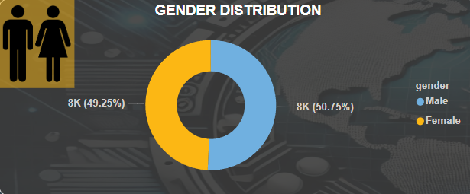
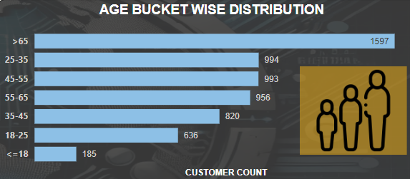
Customer Analysis
Gender Analysis:
We can see the male customers are dominating in number when compared to female
Female targeted advertisements can help us fight this imbalance and grow overall sales
Age Analysis:
The customers are bucketed based on their age and then visualised using the bar chart.
We can see that the people above 65 years are higher in counts than others age bucket.

Slide 4
Customer Analysis
Gender Analysis:
We can see the male customers are dominating in number when compared to female
Female targeted advertisements can help us fight this imbalance and grow overall sales
Age Analysis:
The customers are bucketed based on their age and then visualised using the bar chart.
We can see that the people above 65 years are higher in counts than others age bucket.

Slide 5
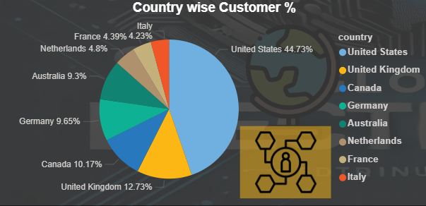
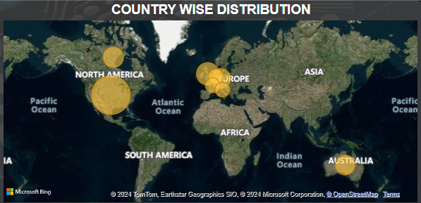
Customer Analysis
Country wise Customers %:
We can see top customers contributes by United States with 45%.
Followed by United Kingdom (13%), Canada and Germany (10%).
Country wise Analysis:
The locations wise analysis was represented using the world map.
The size of the bubble says about the intensity of sales from that area.
The country wise analysis suggests that the North America is having Highest sales.

Slide 6
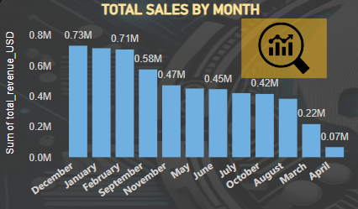
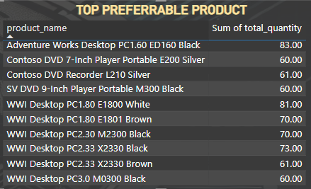
Sales Analysis
Monthly sales:
We can see the highest sales are there in Jan, Feb and Dec for which the inventory should be ready to face the hike in demand.
The April and march month has recorded the lowest sales which can be overcome by doing proper marketing, offers, discounts and maintaining good product portfolio.
Top Performers:
We can see that the computers are the top performers maintaining good based on colours is important as we can see god proportion in each colour.

Slide 7
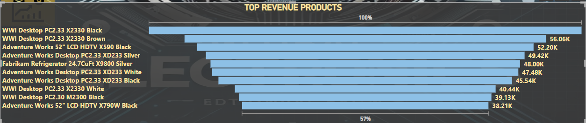
Sales Analysis
Top 10 Revenue Products:
The top selling products are from the Desktop and computer segment.
It’s recommended to provide more offers and discount to the desktop sale, also maintain sufficient volumes to meet the customer demand.

Slide 8
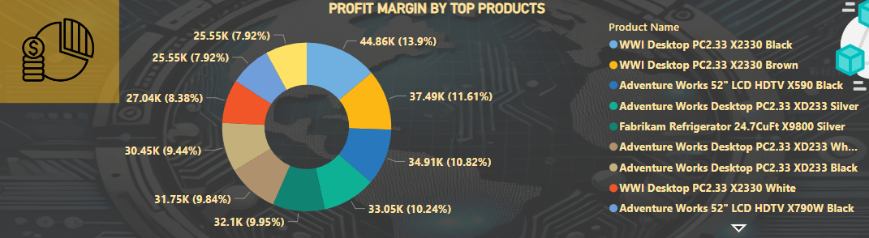
Product Analysis
Profit Margin by Top Products:
From the Donut chat that has been shown for the top 10 products it has been understood that the 10 tier products are not non uniformly distributed, they are properly distributed suggesting good signs.

Slide 9
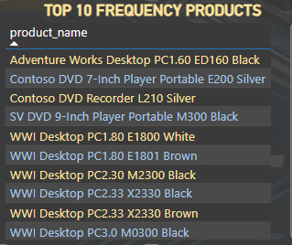
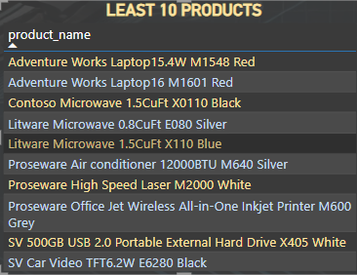
Product Analysis
Top 10 Frequency Products:
The top selling products are from the Desktop and computer segment.
It’s recommended to maintain sufficient inventory to meet the customer demand.
Least 10 Frequency Products:
We can see that the larger proportion of the least 10 products are from home appliances, camera segment.
Making the competitor analysis will help us understand the gaps in our current products.

Slide 10
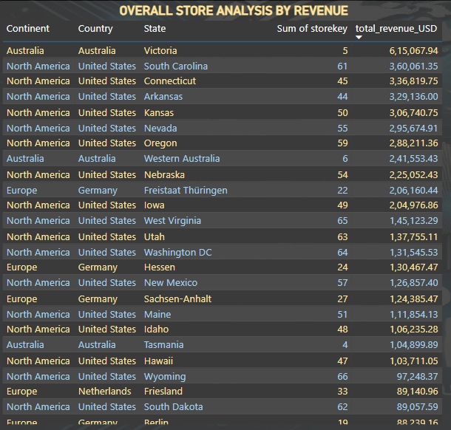
Store Analysis
Overall Analysis:
After seeing the total revenue, it has been understood that the sales from North American stores are the highest.
There are very less number of stores in Australia which can cost us the opportunity.
Spreading the stores across the Australia can help the company grow its sales well.

Slide 11
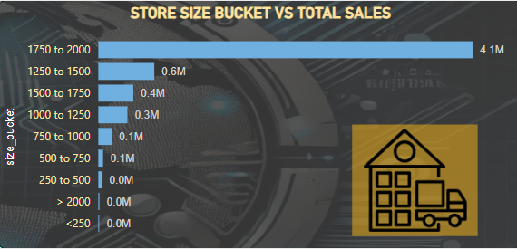
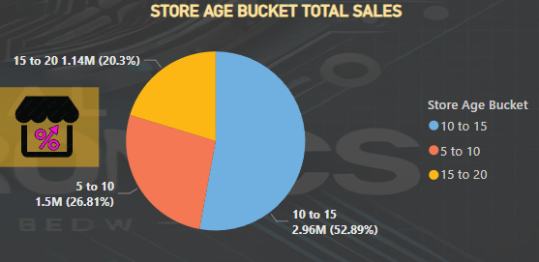
Store Analysis
Store Size analysis:
We can see that the stores with the area between 1750 to 2000 are contributing to morethan 50% of the entire sales.
We can see the stores with the highest area are not the highest selling.
Store Age analysis:
If the age of the store is between 10-15 then they are contributing to the highest amount of sales.

Slide 12
Enhance Product and Service Offering
Product Innovation - Continuously innovate and improve your products or service based on market trends and customer feedback.
Diversification - Expand your product line to cater to a wider range of customer needs or enter new markets.
Quality Assurance - Ensure high-quality standards for your products or services to build trust and encourage repeat purchases.
New Stores – Expand stores to Asian countries focus mainly on Indian markets.

Slide 13
Optimize Pricing Strategies
Competitive Pricing - Analyze competitor pricing and adjust your pricing strategy to remain competitive without compromising profitability.
Dynamic Pricing - Implement dynamic pricing models that adjust prices based on demand, customer segments , or market conditions.
Bundling and Discounts - Offer Product Bundles or discounts to incentivize purchases and increase average order value.

